Slide 1
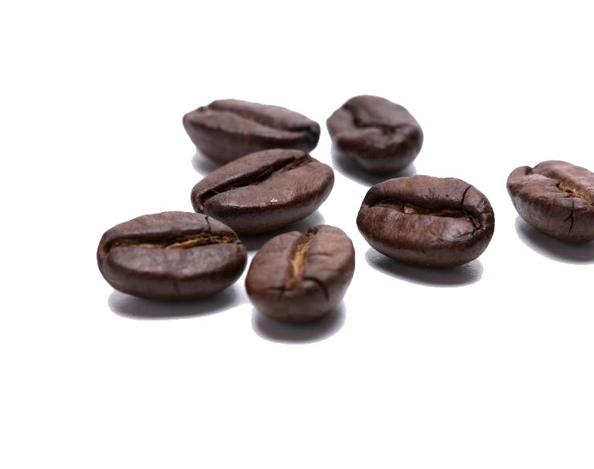
Understanding Coffee Demand
Seasonal Trends, Weather Correlations, Predictive Sales Modelling and Exploring Basket Analysis

Slide 2
The global coffee industry holds a pivotal place in international trade and economies. Ranked among the most traded commodities, it significantly impacts the livelihoods of farmers and the economic landscapes of coffee-producing nations. In the face of shifting consumer preferences, changing weather patterns, and economic fluctuations, coffee continues to thrive. Understanding the core elements influencing coffee consumption is key to unravelling its dynamics.
Numerous factors shape coffee consumption beyond its flavour. External factors like weather patterns and seasonal changes also play a role. By systematically analysing these variables, discernible patterns emerge that can assist in forecasting consumer behaviour and fine-tuning strategies to optimize coffee demand.

Slide 3
OBJECTIVES
1. To Analyse Seasonal Variations: The research seeks to explore how coffee consumption changes across different seasons. By understanding these seasonal trends, the study aims to discern the underlying factors that contribute to variations in coffee demand throughout the year.
2. To Examine Weather-Coffee Relationship: Investigating the correlation between weather conditions and coffee orders. This involves understanding whether specific weather patterns, such as rainy days, have an impact on the volume of coffee orders and their flavour.
3. To Develop Predictive Models: The research strives to develop predictive models for coffee demand based on historical data and relevant influencing factors. This objective aims to forecast coffee consumption trends.
4. To Identify Cross-Selling Opportunities: Through basket analysis, the research aims to identify correlations between coffee and other products purchased together. This objective seeks to uncover potential cross-selling opportunities that businesses can leverage to enhance sales and customer experience.

Slide 4
VALIDATION
Predictive Validity:
In the absence of real-time sales data, the project will assess the predictive validity of the model using historical data. A portion of the historical data will be reserved for testing the model's predictions. By comparing the model's predictions with actual sales figures from the testing set, the project aims to demonstrate the model's ability to accurately forecast coffee sales based on past patterns.

